Slide 1
Community College Of Phila
A look behind WERC

Slide 2
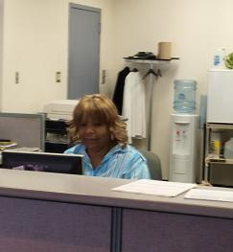
At the front is the Administration
We See Eloise At the ready

Slide 3
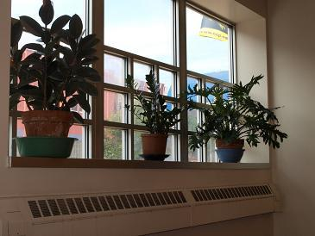
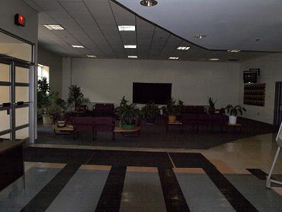
Eloise Tends to her plants that are all around the center
In The Foyer
In the Hallway
At the Entrance

Slide 4
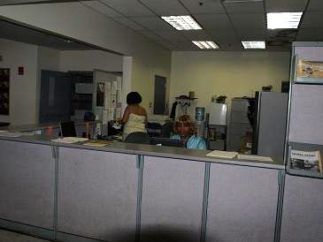
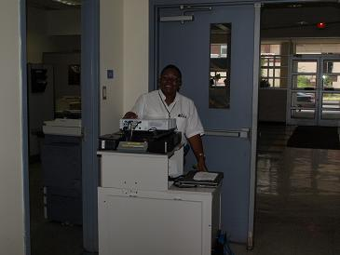
The Staff Is very Helpful
Beverly moves the smart cart
The staff administers to students
Lillian Smith provides a kind word, administrative knowhow and a soft shoulder for both faculty and students

Slide 5
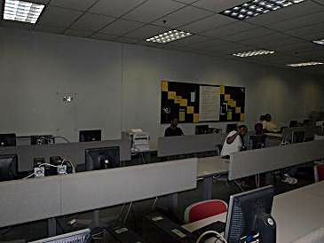
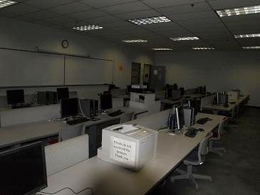
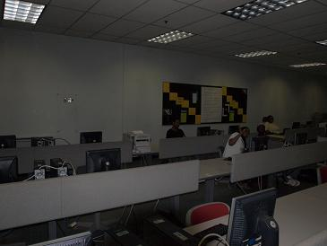
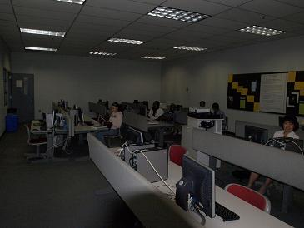
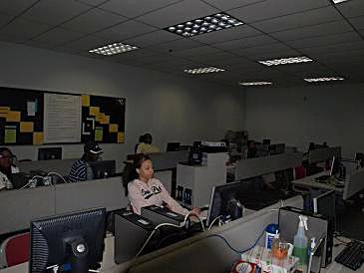
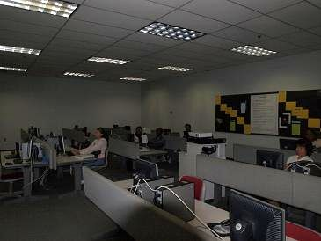
And finally our CIS103 class

